Slide 1
Smart Buy
Buy everything you need in a smart way

Slide 2
Team member
Supervisor: Mr. Kiều Trọng Khánh
Đoàn Hồ Anh Triết
Đặng Hữu Hoàng
Trần Trung Dũng
Huỳnh Thanh Việt (Dropped out)

Slide 3
Outline
Scenario problem
Our solution
Demonstration
Advantages and disadvantages of current solution
Questions and answers
Future Plans

Slide 4
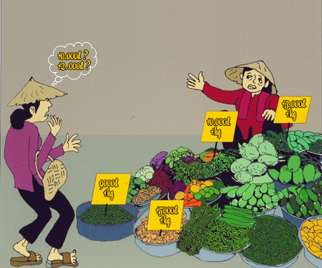
Scenario Problem

Slide 5


Scenario Problem

Slide 6
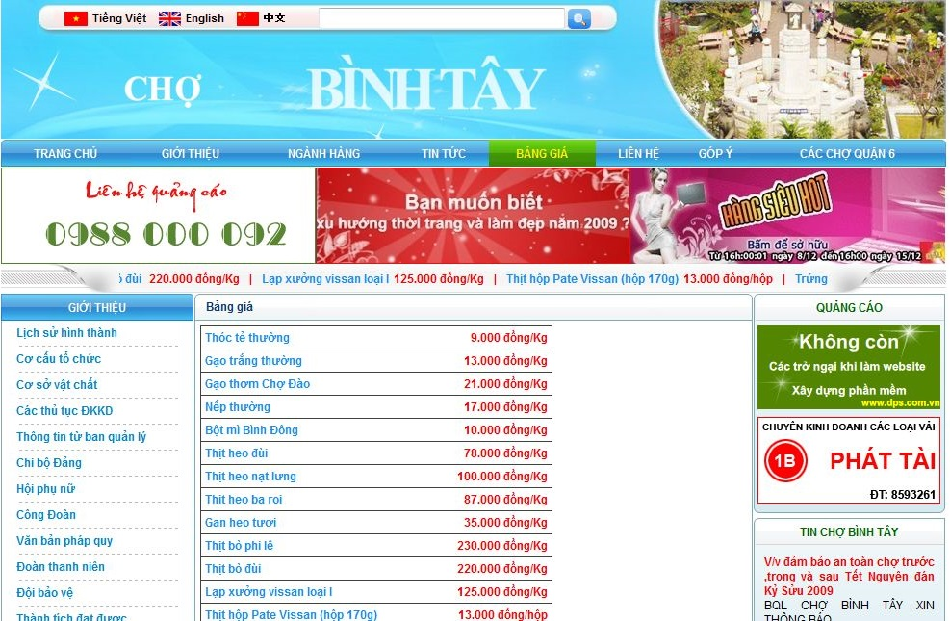
Scenario Problem

Slide 7
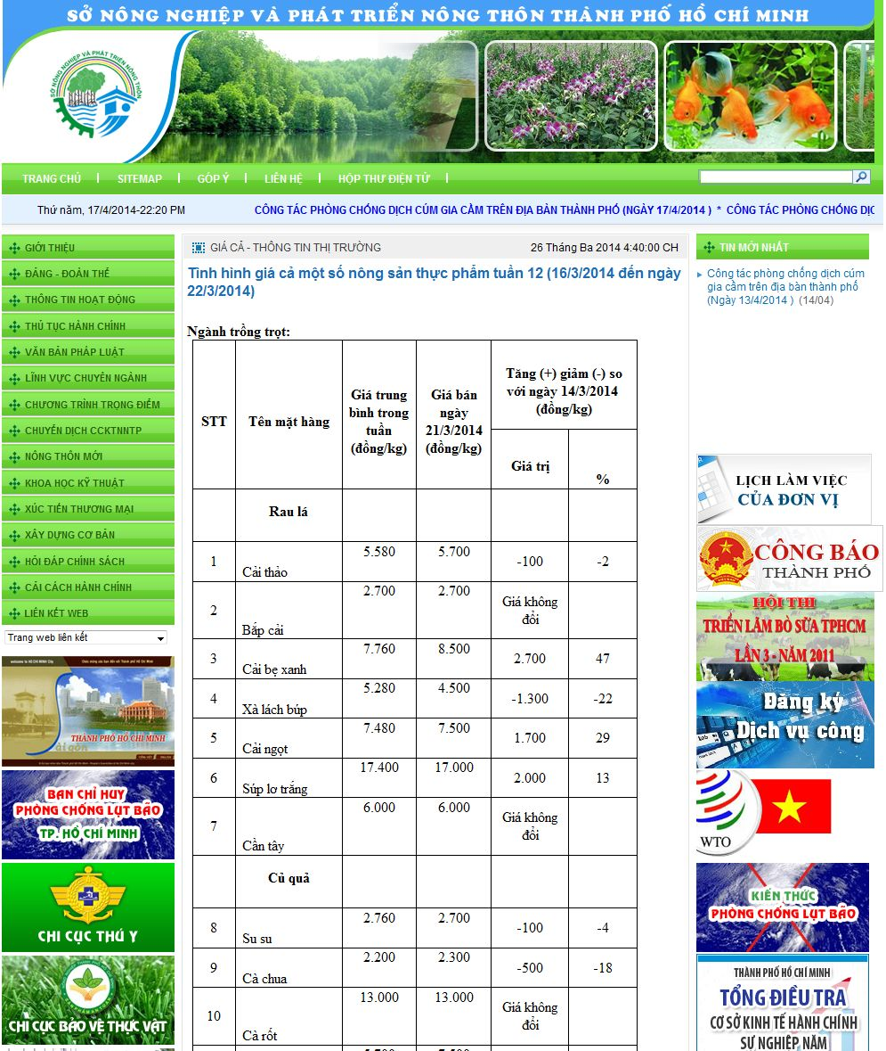
Scenario Problem

Slide 8
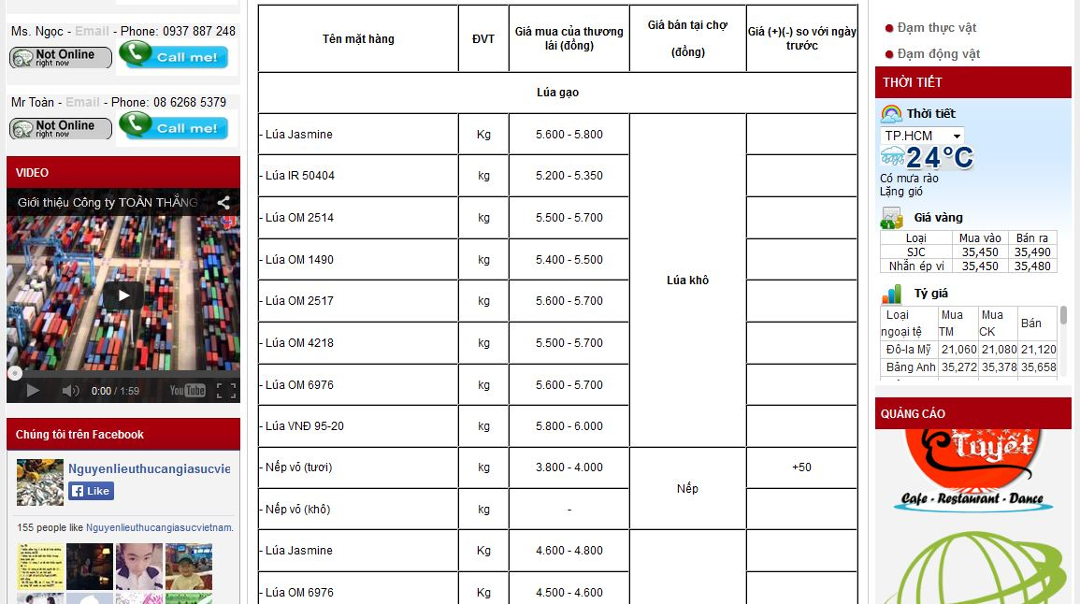
Scenario Problem

Slide 9
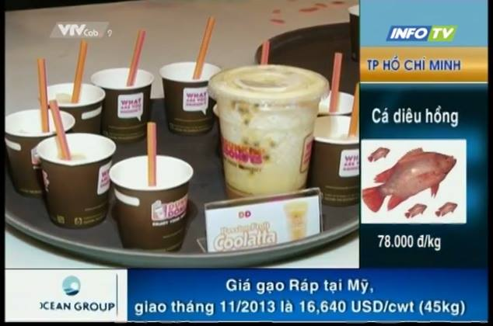
Scenario Problem

Slide 10
Our Ideas
Collect data
Build structure
Public to end user

Slide 11

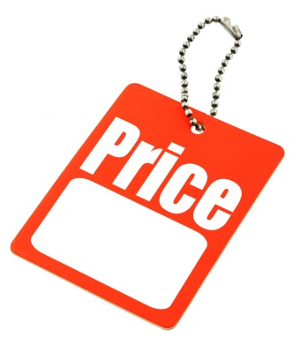

Our Solution
Track
Give
System
Price
Suggestion

Slide 12
Features
Search
Propose price
Estimate total price
Suggestion
Import Excel
Get data from web
Mobile device

Slide 13




Demonstration Story

Slide 14



Story Board
Guest
Member
Staff

Slide 15



Demo Scenario - Guest
Search product
Add to cart.
View cart
View list

Slide 16

Demo Scenario - Member
Define Routes
Ask for suggestion

Slide 17
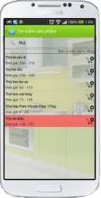


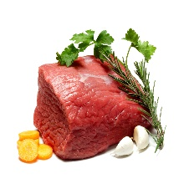








Mobile Member
1.1
Guest
1.2
1.3
2.3
2.6
2.4
2.2
2.5
2.1
Member

Slide 18

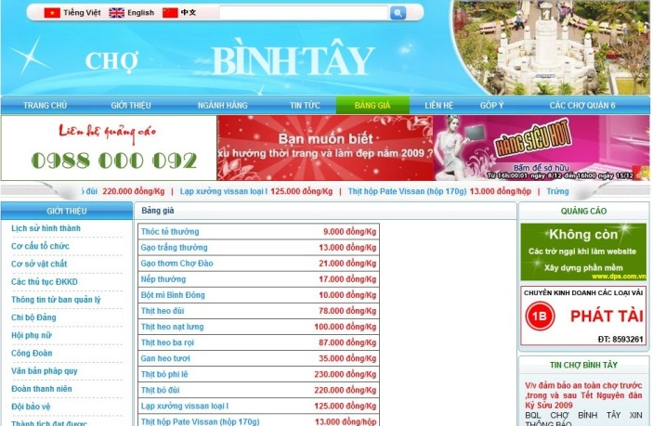
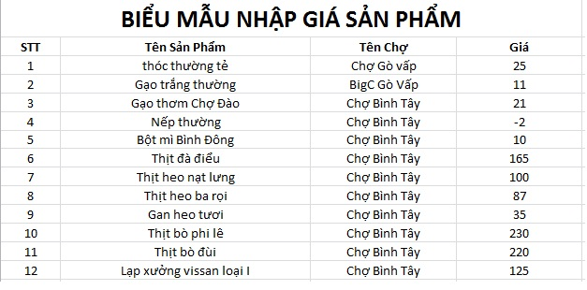

Data Source

Slide 19


Demo Scenario - Staff
Import data
Train machine
Manage parsers

Slide 20
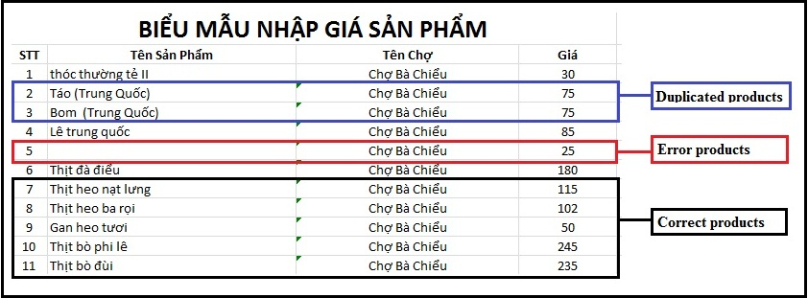
Terminology
Duplicate
Error
Correct
Merge (gộp): make two or more names refer to one product.
Split (tách): different names mean different products.

Slide 21
Import Excel Flow
EXCEL FILE
1
2
3
Correct Products List
Error Products List
Duplicate Products List

Slide 22
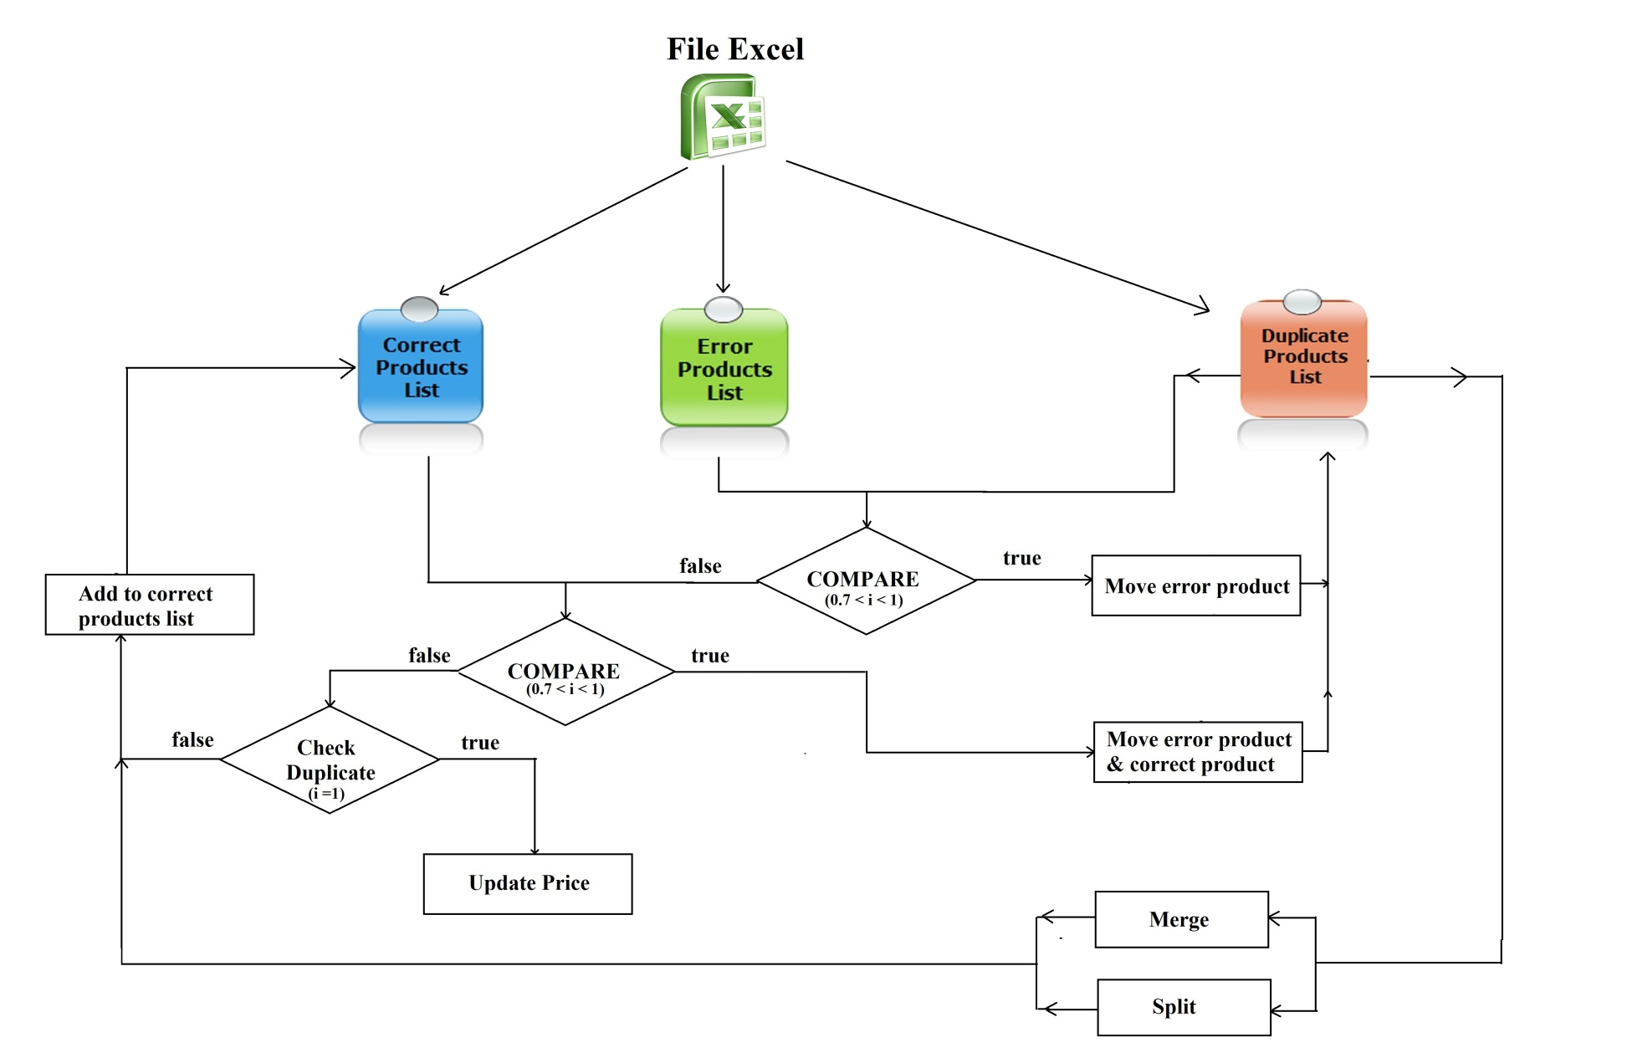
Import Excel Flow

Slide 23
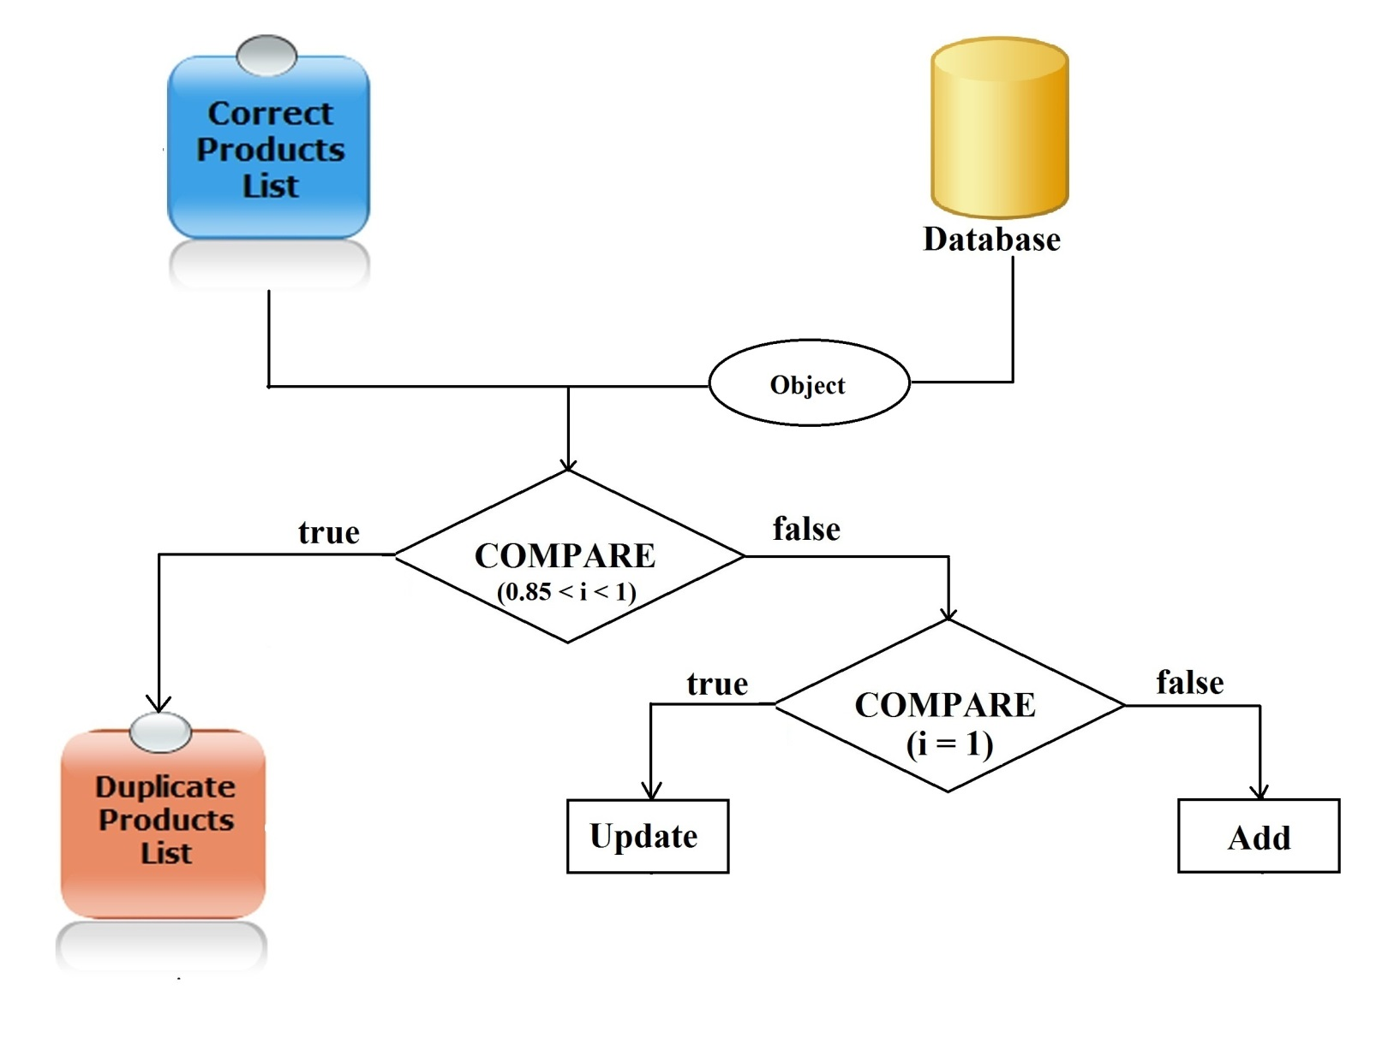
Import Excel Flow

Slide 24
Import Excel Flow
Step 1: Import Excel.
Step 2: Process error products & duplicate products.
Step 3: Save correct products to database.
Step 4: Process duplicate products with database.

Slide 25
Data mining from websites
Get link
Inspect

Slide 26




Smart Buy System
1.1
1.4
Guest
1.2
1.3
2.3
2.6
2.4
2.2
2.5
2.1
Member

Slide 27



Slide 28
Future Plans

Slide 29
THANK YOU FOR YOUR ATTENTION! Q & A

